Slide 1
Master Mumet Unimore Intermediate Project
Project:
Detecting and counting pedestrian in videos by means of HOG
Student:
Majid Mazaheri
01/10/2017

Slide 2
HOG:
The histogram of oriented gradients (HOG) is a feature descriptor used in computer vision and image processing for the purpose of object detection. The technique counts occurrences of gradient orientation in localized portions of an image. This method is similar to that of edge orientation histograms, scale-invariant feature transform descriptors, and shape contexts, but differs in that it is computed on a dense grid of uniformly spaced cells and uses overlapping local contrast normalization for improved accuracy.
Robert K. McConnell of Wayland Research Inc. first described the concepts behind HOG without using the term HOG in a patent application in 1986.[1] In 1994 the concepts were used by Mitsubishi Electric Research Laboratories.[2] However, usage only became widespread in 2005 when Navneet Dalal and Bill Triggs, researchers for the French National Institute for Research in Computer Science and Automation (INRIA), presented their supplementary work on HOG descriptors at the Conference on Computer Vision and Pattern Recognition (CVPR). In this work they focused on pedestrian detection in static images, although since then they expanded their tests to include human detection in videos, as well as to a variety of common animals and vehicles in static imagery.

Slide 3
Nowadays Video surveillance is one of most important fields that magnifies Computer vision’s usefulness .detecting pedestrian in videos is in high demand by many application such as auto drive cars .
One of very useful methods for this matter ,is HOG ;
The feature vector produced by these algorithms when fed into an image classification algorithms like Support Vector Machine (SVM) produce good results.
Fortunately this feature in Open-cv library exists

Slide 4
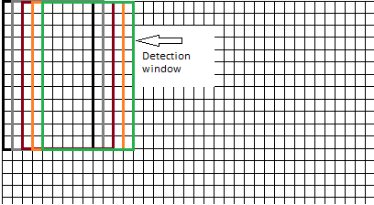
Tuning HOG function:
found, w = hog.detectMultiScale(frame, winStride=(4,4), padding=(8,8), scale=1.05)
winStride: this parameter defines how sliding windows of HOG behaves ,as small as it is, works more accurately but gets very slow. In my case , 4 ,finds very accurately but works very slow and when I try 8 it is fast but gives very poor results
padding Padding adds a certain amount of extra pixels on each side of the input image. That way the detection window is placed a bit outside the input image

Slide 5
Scale :This parameter essentially scales the image down, and then runs the detector again. The hope is, that if people were too big for the detector in the first run, they might be the right size after scaling down. E.g. if your detector size is the default 64x128, but some person in the image is 150px high, the detector might not realize it's a person as it can only view the legs, or the torso at once. If we scale down 150 / 1.2 = 125 the person might now actually be detected.
About the speed I should mention that for getting good results you need a high performance PC . In my case since my pc is slow the results are really slow

Slide 6
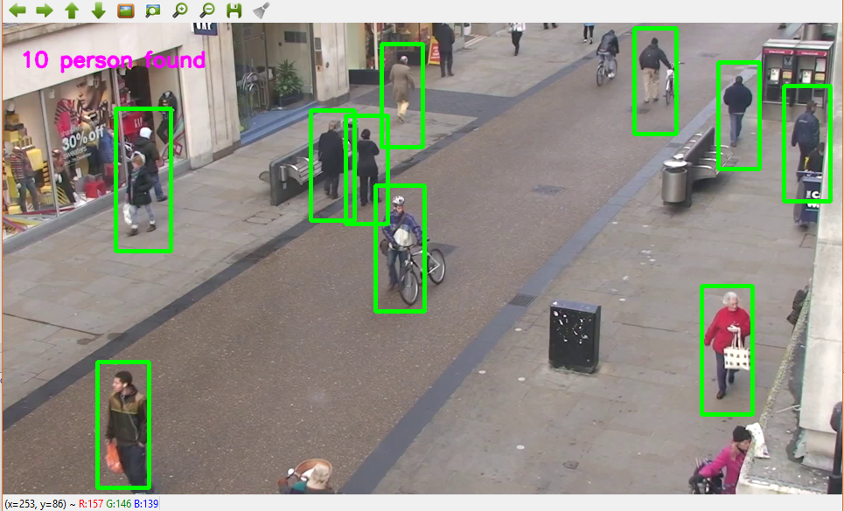
Results
1

Slide 7
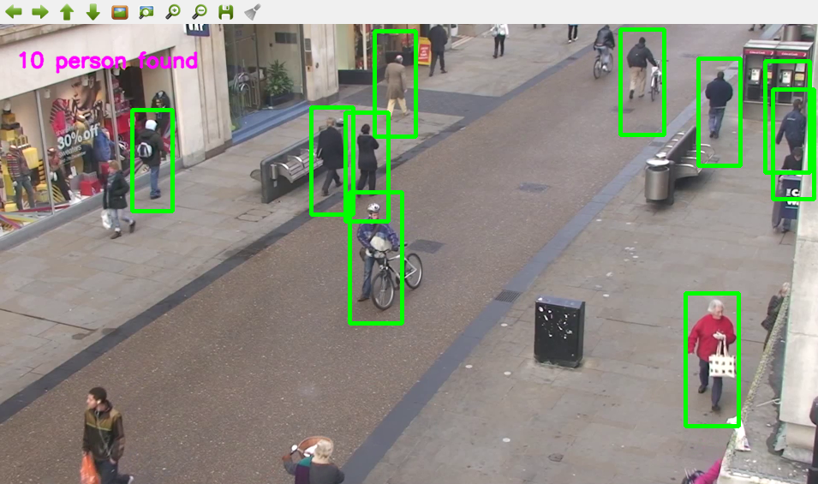
2

Slide 8
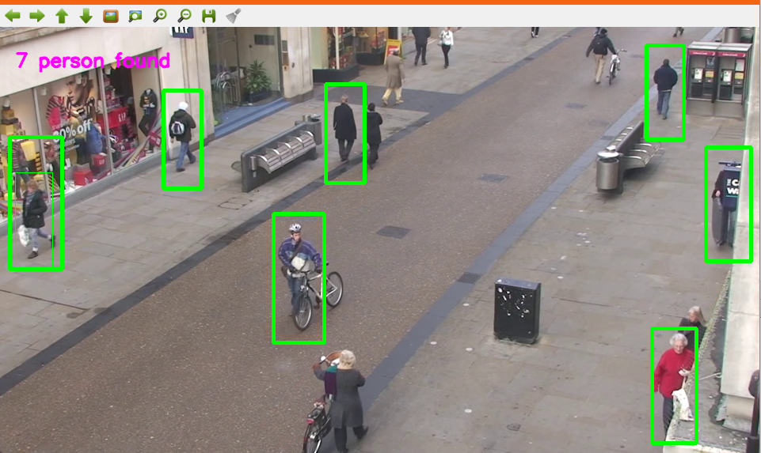
3

Slide 9
Conclusion :
As we can see in above pictures, the result is satisfactory ,but it has some mistakes ,in some frames it fails to separate 2 person close to each other ,and in some frames it fails to detect a person ,and inn some cases it detects some objects as person ,but in general It has high accuracy ,and if it is used on strong machine it will work in real time

